Slide 1

Canadian Bioinformatics Workshops
www.bioinformatics.ca

Slide 2

In collaboration with
Cold Spring Harbor Laboratory
&
New York Genome Center

Slide 3

Module #: Title of Module
3

Slide 4
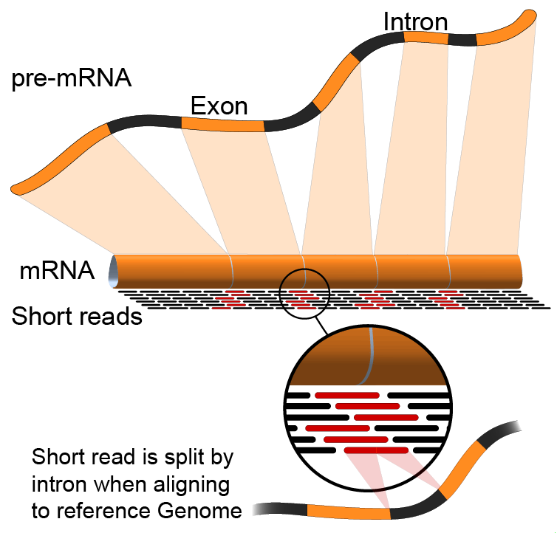
Module X
Module title
Malachi Griffith & Obi Griffith
High-throughput Biology: From Sequence to Networks
April 27-May 3, 2015

Slide 5
We are on a Coffee Break & Networking Session

